Slide 1




First magnetar in a binary system?
By: Clarissa Pavao
Mentor: Noel D. Richardson,
Herbert Pablo, Andre-Nicolas Chene

Slide 2
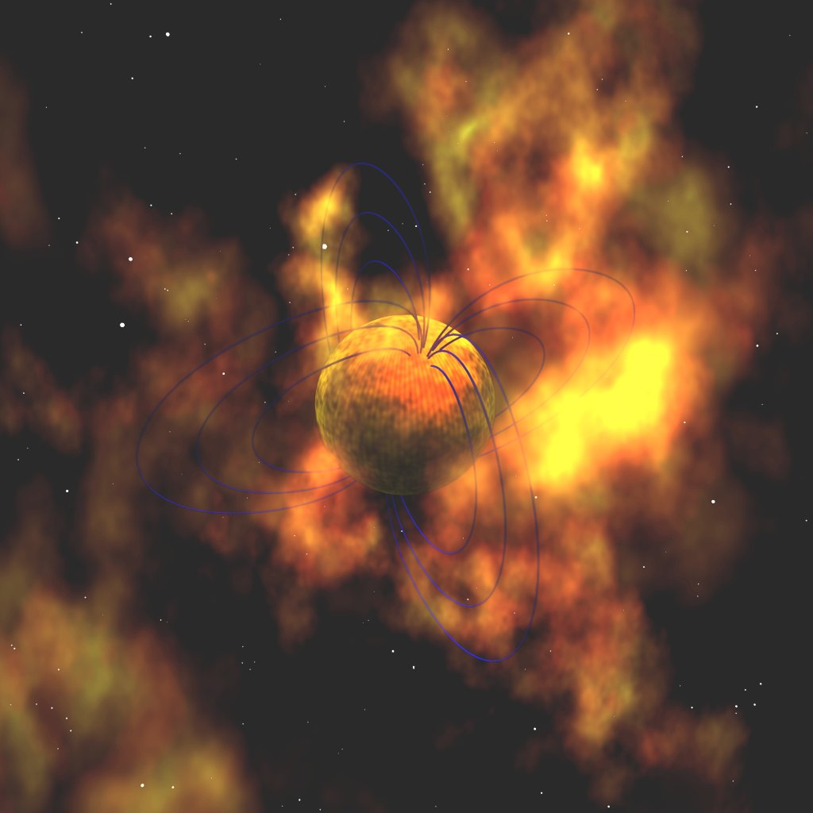
Project summary
Swift detected new magnetar candidate
Magnetars are young and highly magnetized neutron stars
Be star was found by this magnetar
Spectroscopic orbit
Possible binary system
https://apod.nasa.gov/apod/ap980527.html
Credit: Robert Mallozzi (UAH, MSFC)

Slide 3
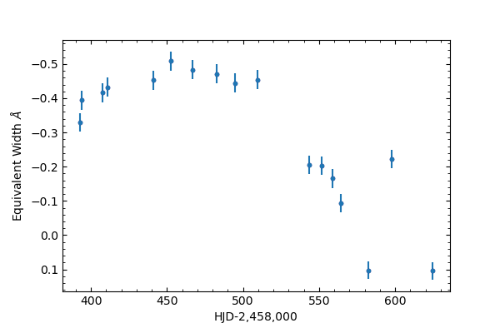
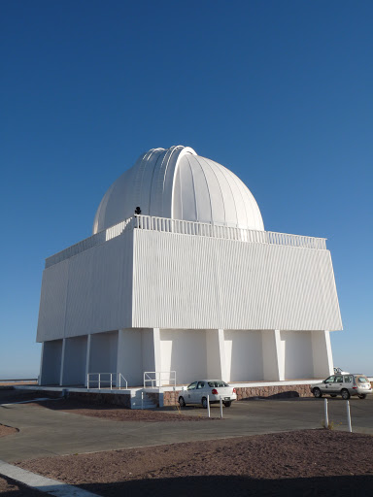
Spectroscopy
Fig. 1: The plot above shows the equivalent width of He I 5876 of CPD-29 2176 taken from CTIO.
Disk variability from Spectroscopy
Helium and Hydrogen lines
Long-term variability
Cerro Tololo Inter-American Observatory | ast.noao.edu. (2021). Retrieved 2 April 2021, from http://ast.noao.edu/facilities/ctio

Slide 4
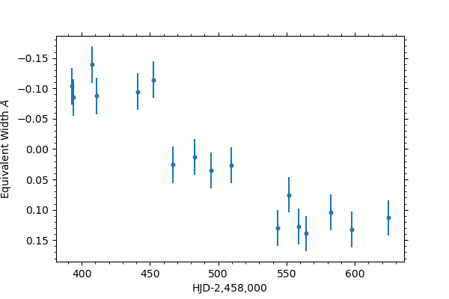
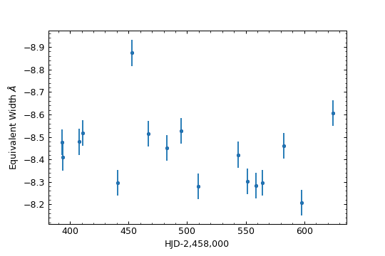
Spectroscopy
Fig. 2: The plot above is the equivalent width of He I 6678 of CPD-29 2176, taken from CTIO.
Fig.3: The plot above is the equivalent width of H-alpha CPD-29 2176, taken from CTIO.

Slide 5
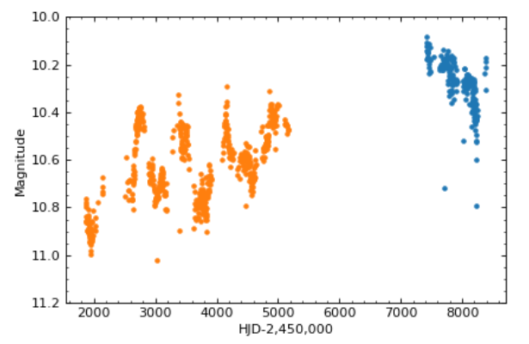
Photometry
Fig 4: The plot above shows the photometry from ASAS and ASAS-SN of CPD-29 2176.
ASAS – All Sky Automated Survey
ASAS-SN – All Sky Automated Survey for Supernovae

Slide 6
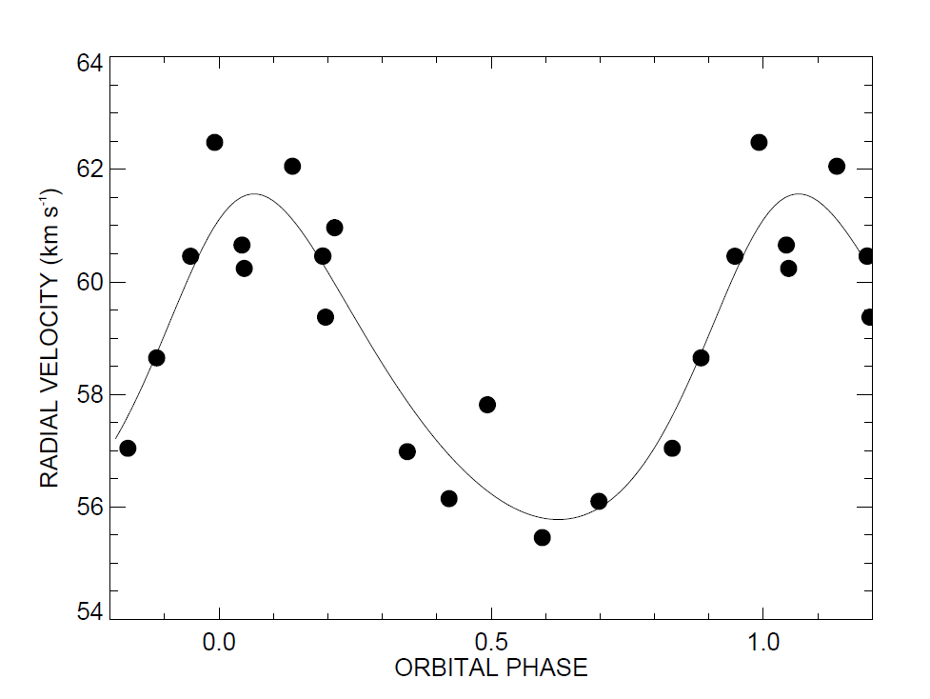
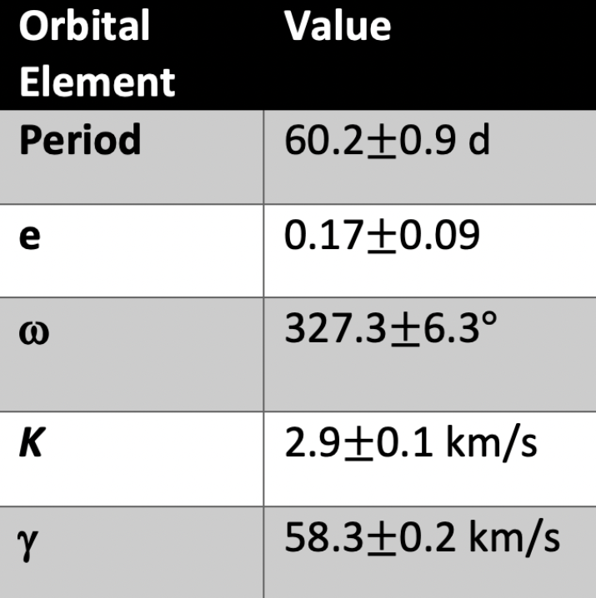
Radial Velocity
Fig 5: The plot above shows our derived spectroscopic orbit of CPD-29 2176.
Spectroscopic orbit
Radial velocity
Orbital elements

Slide 7
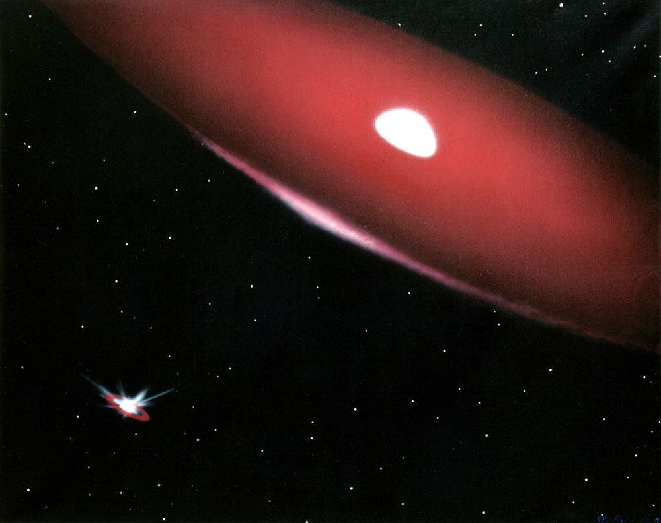
Results
Consistent with a magnetar companion
Low mass – neutron star (magnetar)
Mild eccentricity
Long-term variability
Spectroscopic orbit
Moving forward
More spectra
This is a depiction of the Be binary Phi Per (painting by Bill Pounds). This shows a representation of the large disc around the Be star with a small compact object (bottom left). Even though this is not the exact type of binary that we have, it shows a similar idea.

